Slide 1
2023 Regular Legislative Session - Energy Recap
Graham Platz
West Virginia Department of Commerce, Deputy General Counsel

Slide 2
Completed Legislation
Summary of completed legislation related to the Public Energy Authority
6 bills
Senate – 3
House – 3
Additional information available on Legislature’s Website
https://www.wvlegislature.gov/

Slide 3
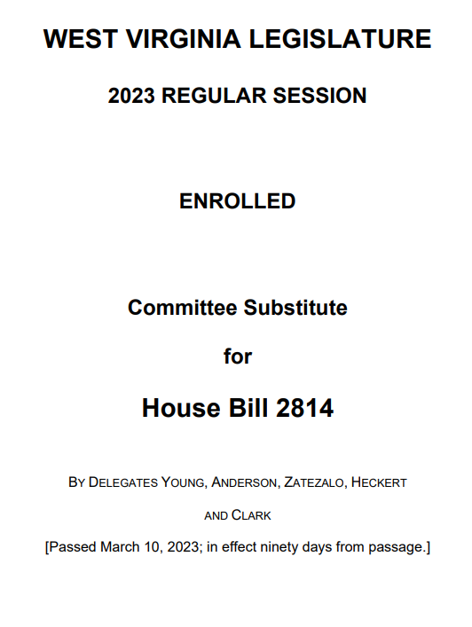
HB 2814 – To create a hydrogen power task force
Operate to take advantage of IIJA and IRA tax incentives related to energy
Study how State can improve its regulatory framework
Work to develop a workforce compatible with industry jobs

Slide 4
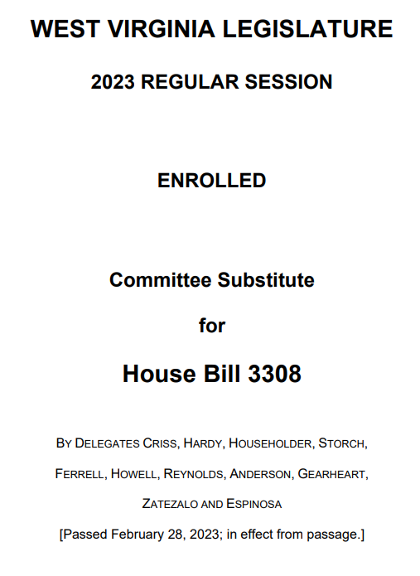
HB 3308 – Authorizing PSC to consider and issue financing orders to certain utilities to permit the recovery of certain costs through securitization via consumer rate relief bonds
Expansion of alternative financing methods
PSC must approve of any public electric utility requirement
Eligible costs: environmental control costs, expanded net energy costs, storm recovery costs, undepreciated generation plan balances
Utility customers cannot bypass the consumer rate relief charges authorized by the PSC

Slide 5
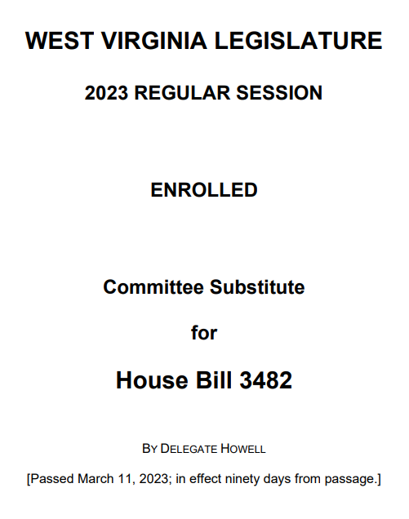
HB 3482 – To create the Coal Fired Grid Stabilization Act of 2023
Coal has and will continue to be crucial to WV’s electric generation
The act supports regulatory review and continued investment in the industry
Sec. of Econ. Dev. authorized to designate sites for coal-fired generation by evaluating economic, environmental, and geographic viability
Implementation of new and green technologies/fuel sources

Slide 6
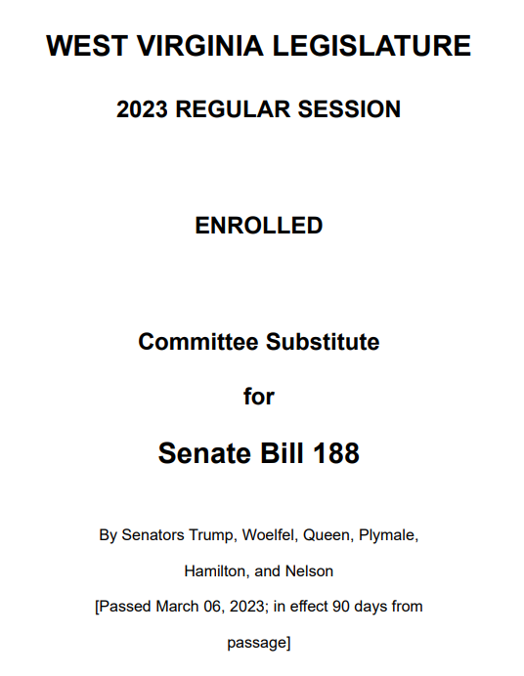
SB 188 – Grid Stabilization and Security Act of 2023
Electric generation from natural gas is underdeveloped in WV.
Encourages regulatory review and tasks Dept. of Economic Development with supporting this industry.
Sec. of Econ. Dev. authorized to designate sites for natural gas generation by evaluating economic, environmental, and geographic viability.
Does not authorize sale of end-use electricity.

Slide 7
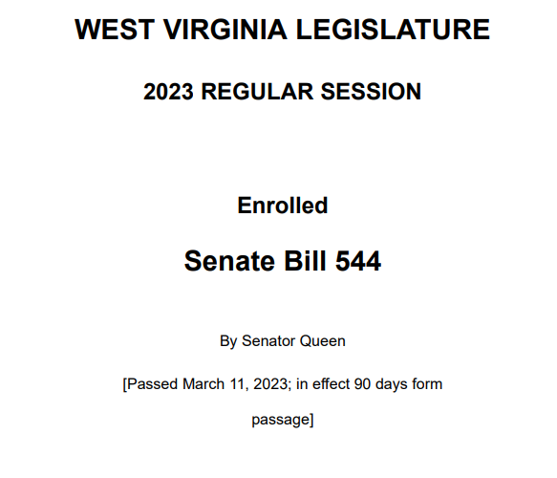
SB 544 – Increasing power purchase agreement cap
Increases the kilowatts allowed for customers who installed solar panels, subject to a power purchase agreement, and designed to service only that customer
Residential: 25kW to 50kW
Commercial: 500kW to 1000kW
If under limit, not a public service under the PSC’s jurisdiction

Slide 8
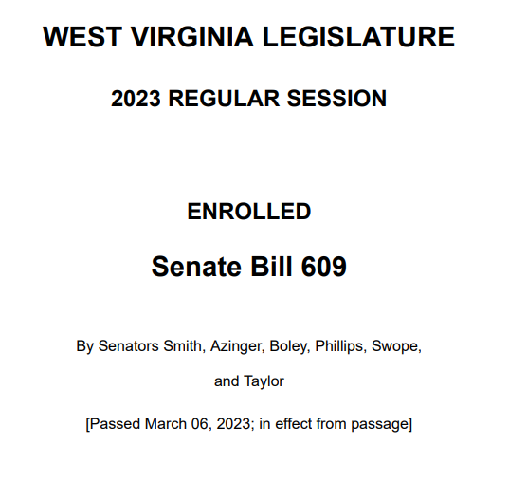
SB 609 – Obtaining approval for decommissioning or deconstructing of existing power plant
Public Energy Authority must approve of the decommissioning of any coal, oil, or natural gas plant
Factors considered for decommissioning: economic, social, environmental
Prior to closure alternative/green technologies and fuel sources should be considered

Slide 9
SB 609
Authority is required to promulgate rules to govern the decommissioning process
Petition Requirements
Considerations of the board
Exemption for nonproducing plants within last five years
Appeal process
Authority is also required to promulgate emergency rules

