Slide 1
www.energywv.org

Slide 2
Bipartisan Infrastructure Law - Section 40101(d)
Preventing Outages and Enhancing the Resilience of the Electric Grid
West Virginia
Microgrid Development Program
West Virginia Public Energy Authority
March 29, 2023

Slide 3
Objective: To improve the resilience of the electric grid against disruptive events through:
a) weatherization technologies, equipment
b) fire-resistant technologies and fire prevention systems
c) monitoring and control technologies
d) undergrounding electrical equipment
e) utility pole management
f) relocation of power lines; reconductoring
g) vegetation and fuel-load management
h) microgrids; battery-storage subcomponents
i) adaptive protection technologies
j) advanced modeling technologies
k) system hardening
l) conductor and underground cable replacement
Applications due: May 31, 2023

Slide 4
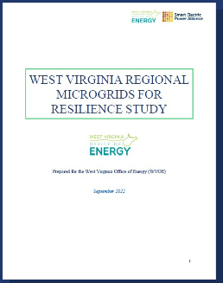
Energy efficiency first priority

Slide 5
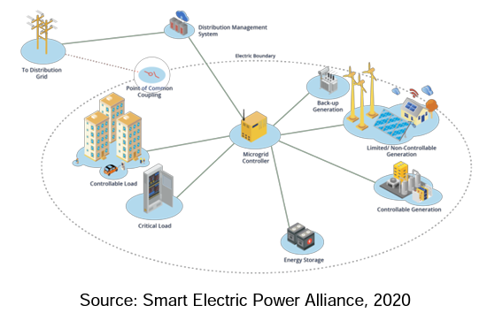
A microgrid is a group of interconnected loads and distributed energy resources (DERs) within clearly defined electrical boundaries that acts as a single controllable entity with respect to the grid. A microgrid can connect to and disconnect from the grid to enable it to operate in both grid-connected or island mode.

Slide 6
The “West Virginia Microgrid Development Program” (WVMDP) will allow WVOE, in consultation with stakeholders including the West Virginia Emergency Management Division (WVEMD) to increase resilience in many regions of West Virginia to ensure residents have efficient, appropriately cooled/heated building(s) capable of providing electricity - even during outages - and a safe haven during natural hazards including floods, extreme cold and winter storms, wind, landslides, tornadoes, extreme heat, mine subsidence, earthquakes, karst, wildfires, and hurricanes. (Smart Electric Power Alliance [SEPA] natural hazards list, p. 18, “West Virginia Regional Microgrids for Resilience Study,” September 2022, https://sepapower.org/resource/west-virginia-regional-microgrids-for-resilience-study/, referred to throughout as “the study.”)

Slide 7
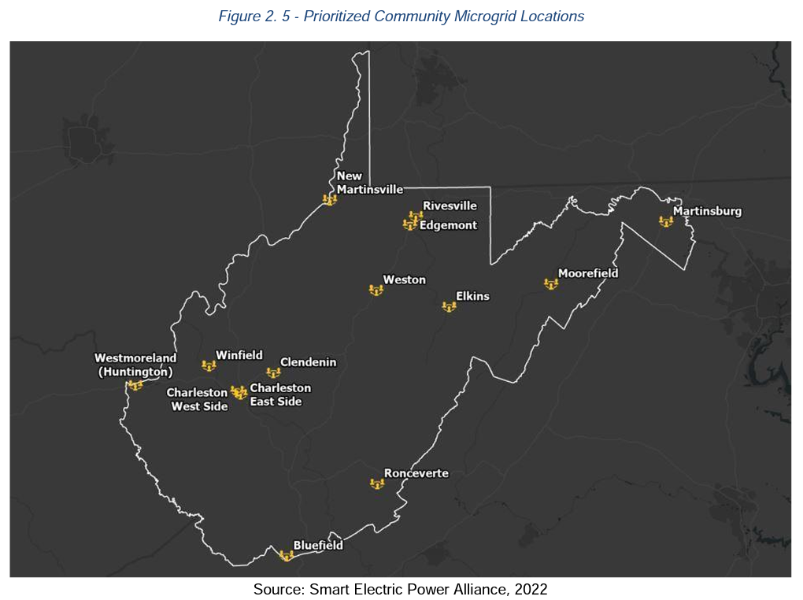

Slide 8
Consultations with
WV Department of Economic Development
AEP
MonPower
To prioritize list
~$4 million annually for five years
Perform energy efficiency assessments/retrofits
Perform solar assessments
Perform storage assessments/retrofits

Slide 9
West Virginia Regional Microgrids for Resilience Study
A deeper dive into geospatial evaluation of resilience needs across the state.
Smart Electric Power Alliance, September 2022
https://storymaps.arcgis.com/collections/575f313f08f847e4bab271953947d212

Slide 10
Thank you!
Contact:
Karen R. Lasure (304) 352-3995, karen.r.lasure@wv.gov
Kelly A. Bragg (304) 206-8713, kelly.a.bragg@wv.gov

